Slide 1
SOLID Principle
S: Single Responsibility Principle (SRP)
- Jitendra Soni

Slide 2
Let’s check the definition
Robert C. Martin expresses the principle as, "A class should have only one reason to change,"

Slide 3
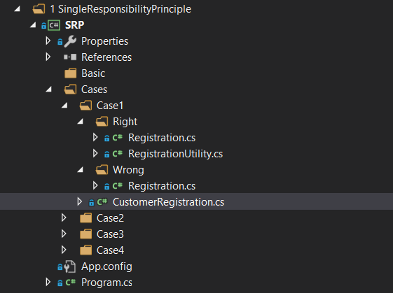
Case - 1
Customer Registration Functionality –
Wrong Design
Right Design

Slide 4
Let’s do the practical for a few Cases
Git Repository
https://github.com/jitendrasoni/PracticeMVC/tree/master/PracticeMVC/PracticeMVC/Console/Solid/SRP

Slide 5
Question and Answers

